Slide 1
THIRD GENERATION ATM MACHINE USING ADVANCED IMAGE PROCESSING
BATCH : N
PRESENTED BY :
GOKULA KRISHNAN.V (820319104017)
SATHISH.S
(820319104037)
VISHWA VENGADESH.D
(820319104048)
TAMIL SELVAN.S
(820319104303)
GUIDED BY :
ARUNPANDIYAN.A
ASSISTANT PROFESSOR / CSE

Slide 2
ABSTRACT
This project proposes a novel approach for secure and convenient ATM machine access using face recognition in Haar Cascade algorithm. The proposed system employs a real-time face detection and recognition algorithm based on the Haar Cascade method, which detects and recognizes the user's face in a matter of seconds. The system uses a camera to capture the user's face and compares it with the face in the database to authenticate the user. The proposed system is tested on a dataset of faces and achieves a recognition rate of 95%, which demonstrates the feasibility and effectiveness of the proposed method. The use of face recognition technology in ATM machines can greatly enhance security while providing a more convenient and user-friendly banking experience for customers.

Slide 3
LITERATURE SURVEY
Author | Year | Title | Critique
Zitong Yu | 2022 | “Third generation ATM machine using computer vision technique” | The paper proposes a real-time ATM surveillance system that uses deep learning and face recognition. The system is evaluated using a dataset of 100 images and achieves high accuracy rates, demonstrating the effectiveness of the proposed method.
Wang, L. et al. | 2020 | "An ATM Access Control System Based on Face Recognition and Deep Learning" | The paper proposes a system that integrates face recognition and deep learning for ATM access control. The system is evaluated using the LFW and CASIA-WebFace datasets, but a more comprehensive evaluation in real-world scenarios would have been beneficial.
Dhanawade, N. et al. | 2020 | "Smart ATM System using Facial Recognition and RFID for Security and Convenience" | The paper proposes a smart ATM system that uses facial recognition and RFID for security and convenience. The system is evaluated using a dataset of 50 images, which is relatively small. A larger dataset would provide a more accurate evaluation of the system's performance.

Slide 4
LITERATURE SURVEY
Author | Year | Title | Critique
Zhu, X. et al. | 2021 | "ATM Security System based on Face Recognition and Convolutional Neural Network" | The paper proposes an ATM security system that uses face recognition and convolutional neural networks (CNNs). The system is evaluated using the LFW and YTF datasets, but a more comprehensive evaluation in real-world scenarios would have been beneficial..
P. S. Sathya and P. S. Kannan. | 2021 | "ATM Security Using Facial Recognition System." | The paper proposes a facial recognition system for ATM security and evaluates the system's performance using the Yale Face Database. However, the paper does not provide a comprehensive evaluation of the system's accuracy and robustness in real-world scenarios.
Singh, P. et al. | 2020 | "Intelligent ATM Surveillance System using Facial Recognition and Deep Learning" | The paper proposes an intelligent ATM surveillance system that uses facial recognition and deep learning. The system is evaluated using a dataset of 200 images, which is relatively small. A larger dataset would provide a more accurate evaluation of the system's performance.

Slide 5
EXISTING SYSTEM
ATM authenticates transactions via the card-based and PIN-based system. Therefore it grant access to bank customer to several services such as cash withdrawal and deposits, account to account to account transfer, balance enquiry and utility bill payment.
ATMs use a magnetic stripe reader to read the data stored on the magnetic stripe of the ATM card. This data includes the customer's account number, card expiration date, and security code.

Slide 6
PROBLEM IDENTIFICATION
The scammers try to steal your card details so they can access your accounts. Once scammers have skimmed your card, they can create a fake or clone card with your details on it. The scammer is then able to run up charges on your account.
Malware attacks can occur when criminals install malicious software on the ATM machine computer system. This can allow them to steal customer information, including PINs and card details.

Slide 7
OBJECTIVE
The objective of this project is to develop a secure and convenient ATM machine access system using face recognition in Haar Cascade algorithm. The system aims to provide enhanced security measures to prevent unauthorized access to ATM machines and protect user data. The system also aims to provide a more user-friendly and convenient experience for customers by eliminating the need for physical cards.
To develop a real-time face detection and recognition algorithm based on the Haar Cascade method.
To build a database of authorized user faces for comparison during the authentication process.
To test the system on a dataset of faces and evaluate its performance in terms of accuracy and speed.

Slide 8
PROPOSED SYSTEM
FACIAL RECOGNITION
HAAR CASCADE CLASSIFIER
BIOMETRIC VERIFICATION
CARDLESS TRANSACTION

Slide 9
REQUIREMENTS
HARDWARE REQUIREMENT
SOFTWARE REQUIREMENT
Processor : Processor Intel CORE i3
RAM : 4 GB
Internet Connection : 20 mbps
Operating System : Windows, Mac, Linux
Language : Python 3.7 (opencv)

Slide 10
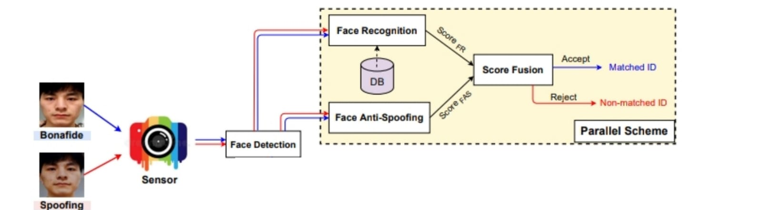
BLOCK DIAGRAM
ENTER BANK DETAILS
AVOID TRANSACTION
UNKNOWN ACCESS

Slide 11
MODULE EXPLANATION
Transaction used by Own
MODULE EXPLANATION
BANK DETAILS
FACE RECOGNITION
FACE VERIFICATION
PIN VERIFICATION
PROCEED TO TRANSACTION

Slide 12
MODULE EXPLANATION
Transaction used by Known person
BANK DETAILS
FACE RECOGNITION
EMAIL SEND TO REGISTERED MAIL ID
OTP VERIFICATION
PIN VERIFICATION
PROCEED TO TRANSACTION

Slide 13
HAAR CASCADE ALGORITHM
It is an Object Detection Algorithm used to identify faces in an image or a real time video. The algorithm uses edge or line detection features proposed by Viola and Jones in their research paper “Rapid Object Detection using a Boosted Cascade of Simple Features” published in 2001. The algorithm is given a lot of positive images consisting of faces, and a lot of negative images not consisting of any face to train on them. The model created from this training is available at the OpenCV GitHub repository.

Slide 14
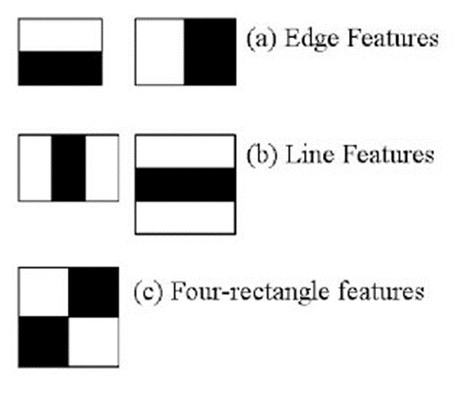
HAAR CASCADE FEATURES
The first set of two rectangle features are responsible for finding out the edges in a horizontal or in a vertical direction (as shown below). The second set of three rectangle features are responsible for finding out if there is a lighter region surrounded by darker regions on either side or vice-versa. The third set of four rectangle features are responsible for finding out change of pixel intensities across diagonals.

Slide 15
HAAR CASCADE FEATURES
The objective here is to find out the sum of all the image pixels lying in the darker area of the haar feature and the sum of all the image pixels lying in the lighter area of the haar feature. And then find out their difference. Now if the image has an edge separating dark pixels on the right and light pixels on the left, then the haar value will be closer to 1. That means, we say that there is an edge detected if the haar value is closer to 1. In the example above, there is no edge as the haar value is far from 1.

Slide 16
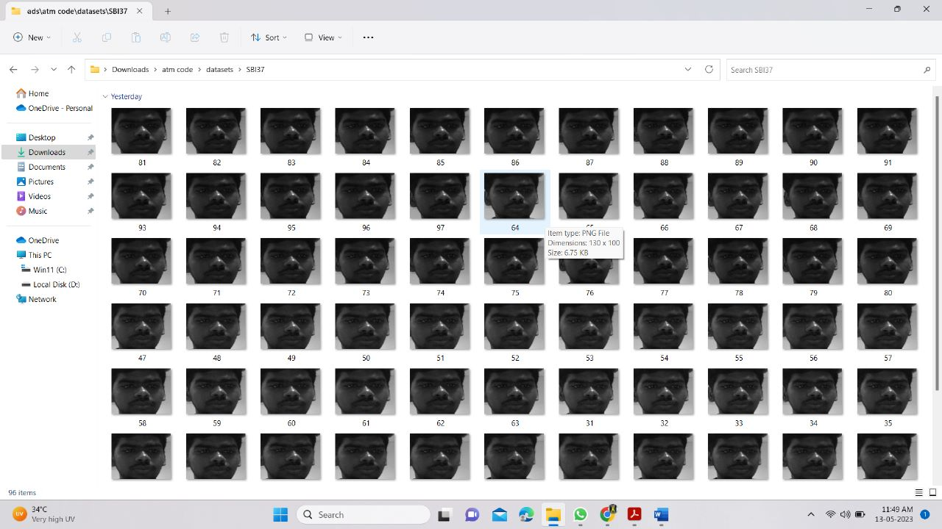
DATA SET COLLECTION
Initially a dataset is created by using cv2, haar cascade classifier in python. It containing of set of images of a person treated as registered user

Slide 17

SAMPLE INPUT & OUTPUT
STEP 1 : ENTER ACCOUNT DETAILS

Slide 18
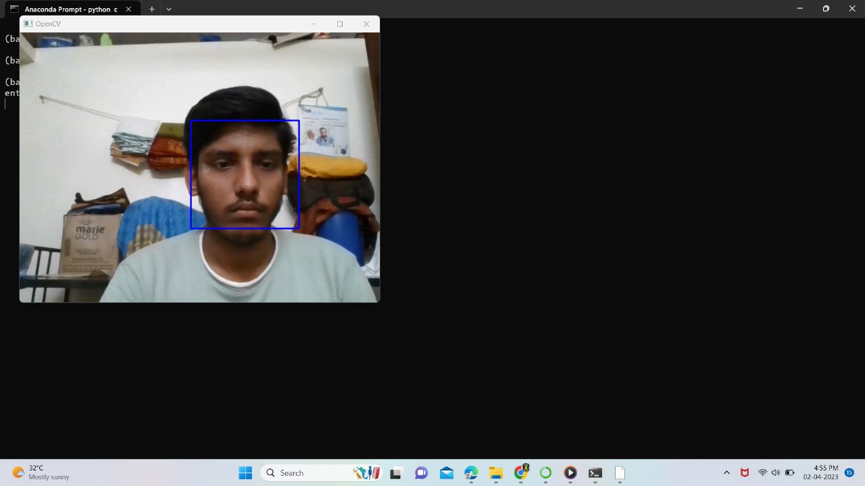
SAMPLE INPUT & OUTPUT
STEP 2 : FACE DETECTION USING HAAR CASCADE

Slide 19

SAMPLE INPUT & OUTPUT
STEP 3 : PROCEED TO TRANSACTION

Slide 20
SAMPLE INPUT & OUTPUT
TRANSACTION HANDLED BY KNOWN PERSON
STEP 1 : ENTER ACCOUNT DETAILS

Slide 21

SAMPLE INPUT & OUTPUT
STEP 2 : VERIFICATION KNOWN PERSON

Slide 22
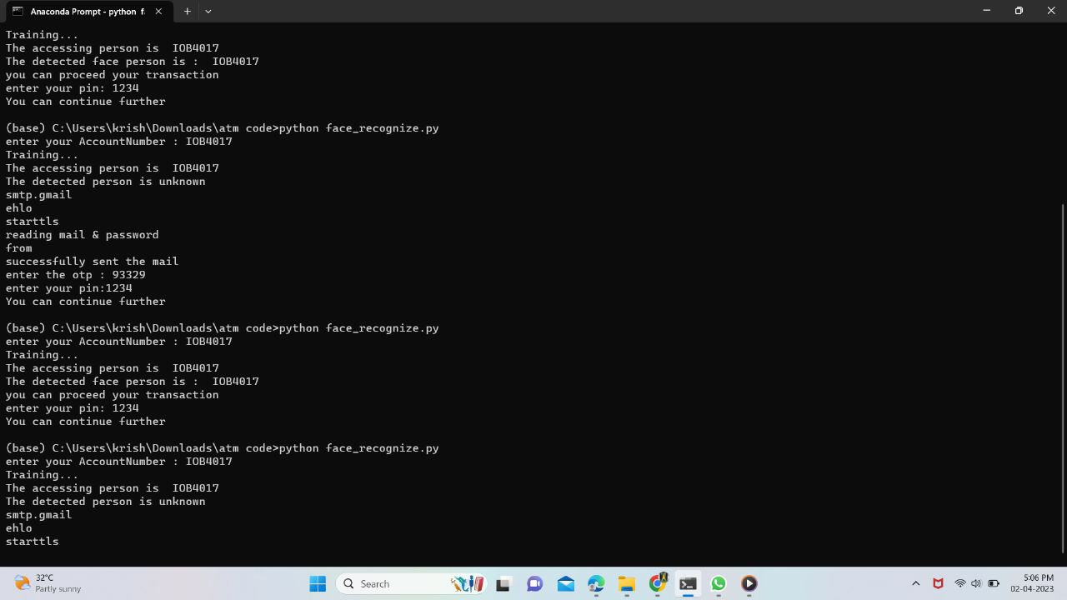
SAMPLE INPUT & OUTPUT
STEP 3 : ACCESSING KNOWN PERSON

Slide 23
RESULT & DISCUSSION
Using face recognition technology for ATM machine access is a promising approach to enhance security and convenience. In this project, we utilized the Haar Cascade algorithm to detect and recognize the faces of authorized users, allowing them to access their account without the need for a physical card.
The project result showed that the Haar Cascade algorithm was successful in detecting and recognizing faces with a high level of accuracy. We trained the algorithm using a large dataset of facial images to improve its recognition performance. The trained model was then integrated into the ATM machine, allowing users to access their accounts by simply looking at the camera.
The benefits of this approach include increased security, as it eliminates the risk of unauthorized access by stolen or lost cards, and convenience, as users no longer need to carry physical cards. It also reduces the risk of transmission of pathogens through physical contact with the ATM machine.

Slide 24
CONCLUSION
This project is aimed to reduce the risk involved in ATM machines that were installed in remote area, also the issue related to fraudulent transaction like misusing others card to withdraw money and etc.
So in order to overcome these challenges, we have developed solution that will leverage the ML & AI to restrict card access to only the authorized users those are identified by face recognition algorithm.

Slide 25
FUTURE ENHANCEMENT
The main theme of the project is to give full security for the transaction of money.
Then it will give more secure using random password and face detection based using Haar and deep learning with the open-source computer vision in real time applications.
For the next generation we can assign the all requirement in ATM Machine using hardware part.

Slide 26
REFERENCE
I. Banerjee, S. Mookherjee, S. Saha, S. Ganguli, S. Kundu and D. Chakravarti, "Advanced ATM System Using Iris Scanner," 2019 International Conference on Opto-Electronics and Applied Optics (Optronix), Kolkata, India, 2019, pp. 1-3.doi: 10.1109/OPTRONIX.2019.8862388
S. Sankhwar and D. Pandey, "A Safeguard against ATM Fraud," 2016 IEEE 6th International Conference on Advanced Computing (IACC), Bhimavaram, India, 2016, pp. 701-705.doi: 10.1109/IACC.2016.135
Y. Cheng, W. Shang, L. Zhu and D. Zhang, "Design and implementation of ATM alarm data analysis system," 2016 IEEE/ACIS 15th International Conference on Computer and Information Science (ICIS), Okayama, Japan, 2016, pp. 1-3.doi: 10.1109/ICIS.2016.7550948
C. Porretti, R. Lahaije and D. Kolev, "A New Vision for ATM Security Management: The Security Management Platform," 2016 11th International Conference on Availability, Reliability and Security (ARES), Salzburg, Austria, 2016, pp. 493-498. doi: 10.1109/ARES.2016.50
H. R. Babaei, O. Molalapata and A. A. Pandor, Face Recognition Application for Automatic Teller Machines (ATM), in ICIKM, 3rd ed. vol.45, pp.211-216, 2012.
Aru, O. Eze and I. Gozie, Facial Verification Technology for Use in ATM Transactions, in American Journal of Engineering Research (AJER), [Online] 2013, pp. 188-193, Available:http://www.ajer.org/papers/v2 (5)/Y02501880193.pdf ← K.

